Slide 1
Edmonds Blossom Simulation
Mathematical Foundation for Computer Science
Aditya Dhananjay Singh - 22CS02001
Kumar Snehal - 22CS02009
Atharva Atul Penkar - 22CS02011

Slide 2
Edmonds Blossom Algorithm
Maximum Matching
It extends augmenting path algorithms by identifying and contracting odd-length cycles, called "blossoms," into single vertices.
This contraction process simplifies the graph, allowing the algorithm to continue searching for augmenting paths to increase the matching size.
Once a maximum matching is found in the contracted graph, the algorithm expands the blossoms to determine the maximum matching in the original graph.
A Maximum Matching in a graph is a set of edges where no two edges share a common vertex, and it is the largest possible such set.
Edmond Blossom Algorithm
The Edmonds Blossom Algorithm is a method for finding a maximum cardinality matching in a general graph (not restricted to bipartite graphs).

Slide 3
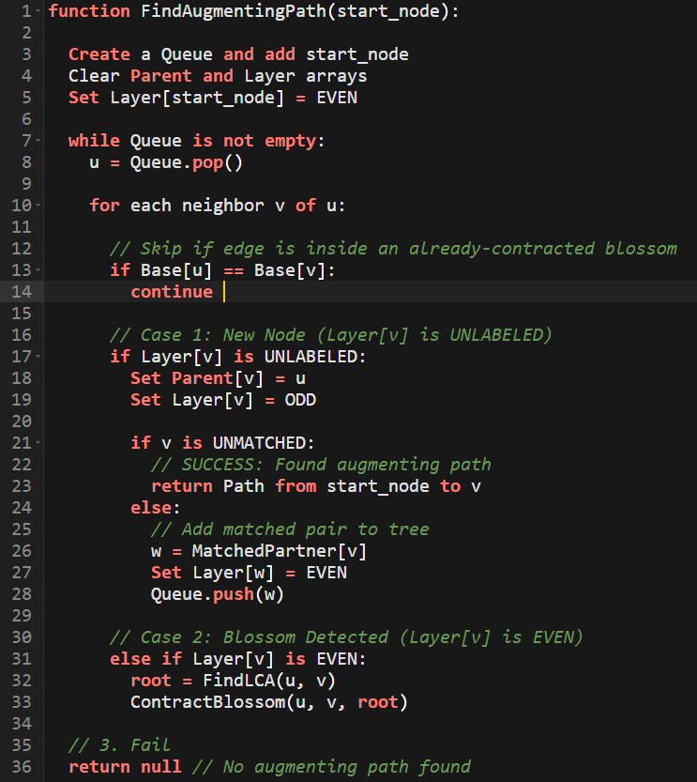
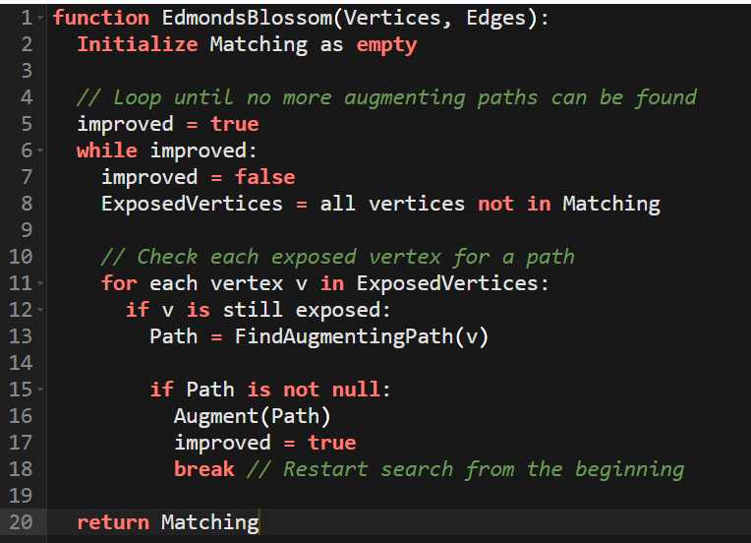
Pseudo-Code

Slide 4
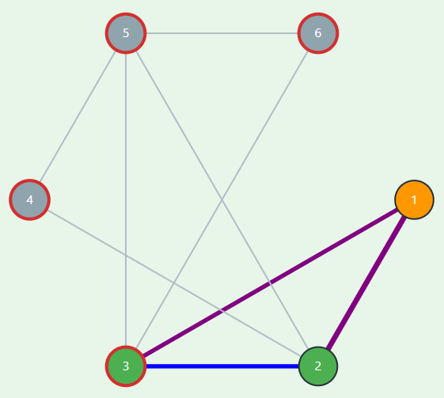
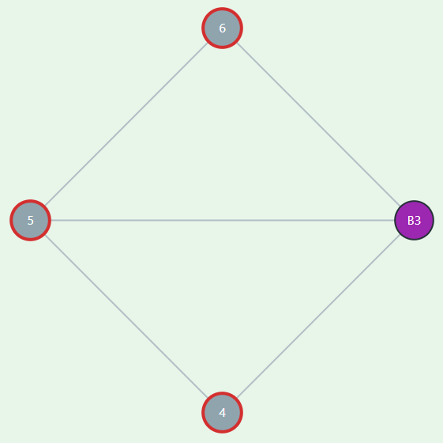
Blossom Contraction
Blossom Contraction

Slide 5
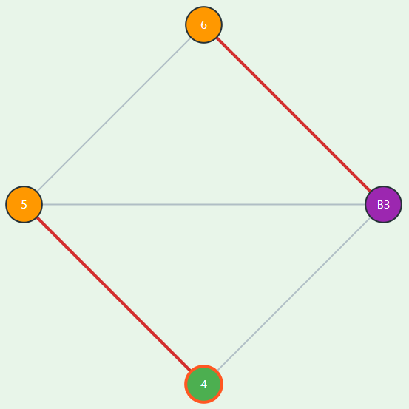
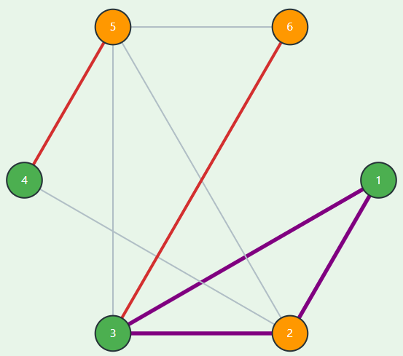
Blossom Expansion

Slide 6
Working of Algorithm
Data Structures
Key operations
Matching Array []: matching array
Par[]: parent pointer for alternating trees
Base[]: current blossom base for each vertex
Status[]: EVEN/ODD/UNLABELED
Adj[]: adjacency list
blossomMap: blossom base → vertices in blossom
BFS search: builds alternating trees
LCA computation: finds blossom base
markPath: sets parents & compresses blossoms
contract: creates new blossom
expandBlossom: restores original vertices
augment: follows alternating path, expands blossoms, flips edges

Slide 7
Tech Stack and Libraries used
Core tech stack
Libraries and custom modules
React with TypeScript – Builds the user interface as reusable components, with static typing to catch errors in graph and algorithm state.
Vite (build and dev tool) – Provides a fast development server, hot‑reload, and bundling for the single‑page web application.
HTML5 + CSS3 – Structures the page and styles the layout, forms, and graph area for a clean, responsive interface.
Custom Edmonds’ Blossom logic module – Implements the Edmonds maximum matching algorithm (including blossom handling) and emits step‑by‑step snapshots for visualization.
SVG (Scalable Vector Graphics) via React components – Renders vertices, edges, matchings, and blossoms as shapes, allowing interactive highlighting of each algorithm step.

Slide 8
Demonstration
GitHub Repository

Slide 9
Q&A

